Slide 1
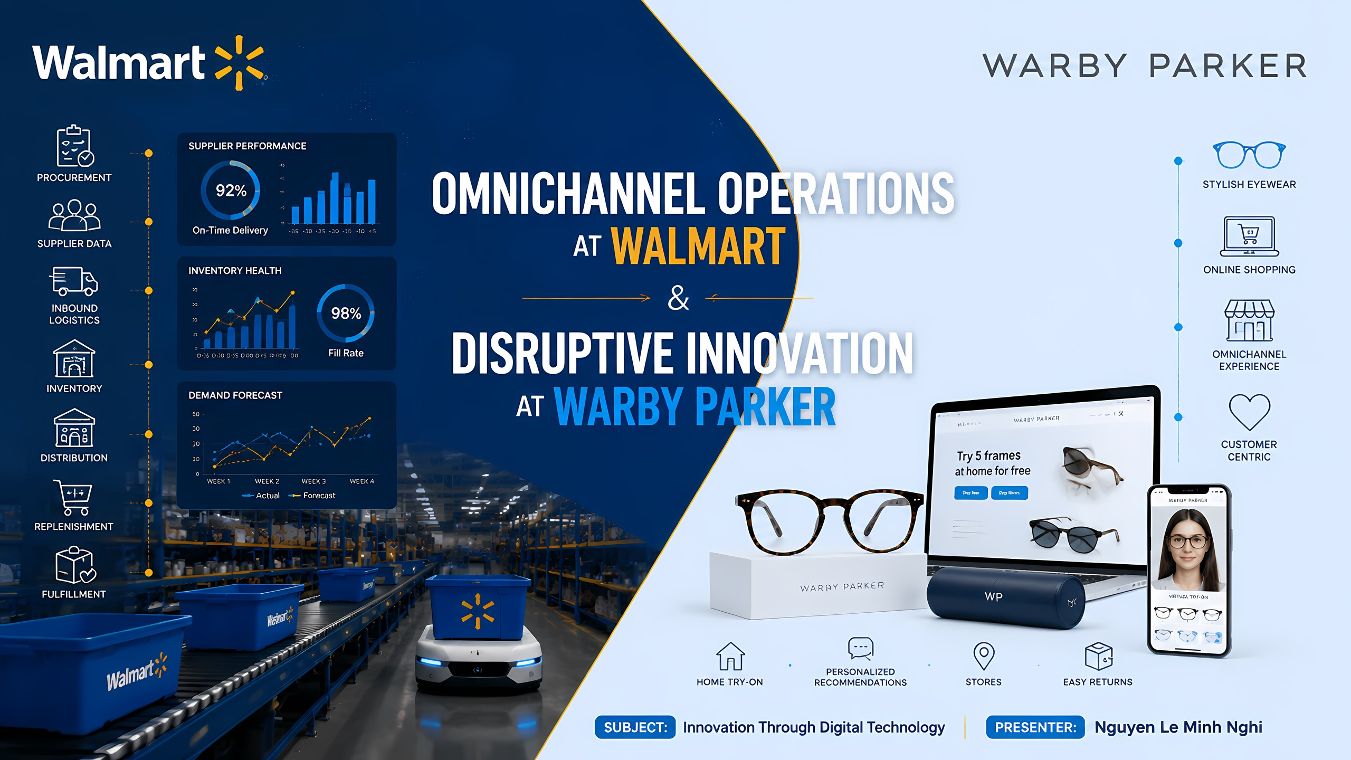
Notes:
Today, I would like to share two cases of innovation through technology: Walmart on the buy-side, focusing on omnichannel operations. When we hear “omnichannel,” we normally think about sales channels. But today, I will look at the operating system that runs behind those channels. And the second case is Warby Parker on the sell-side, focusing on disruptive innovation in the eyewear industry.

Slide 2
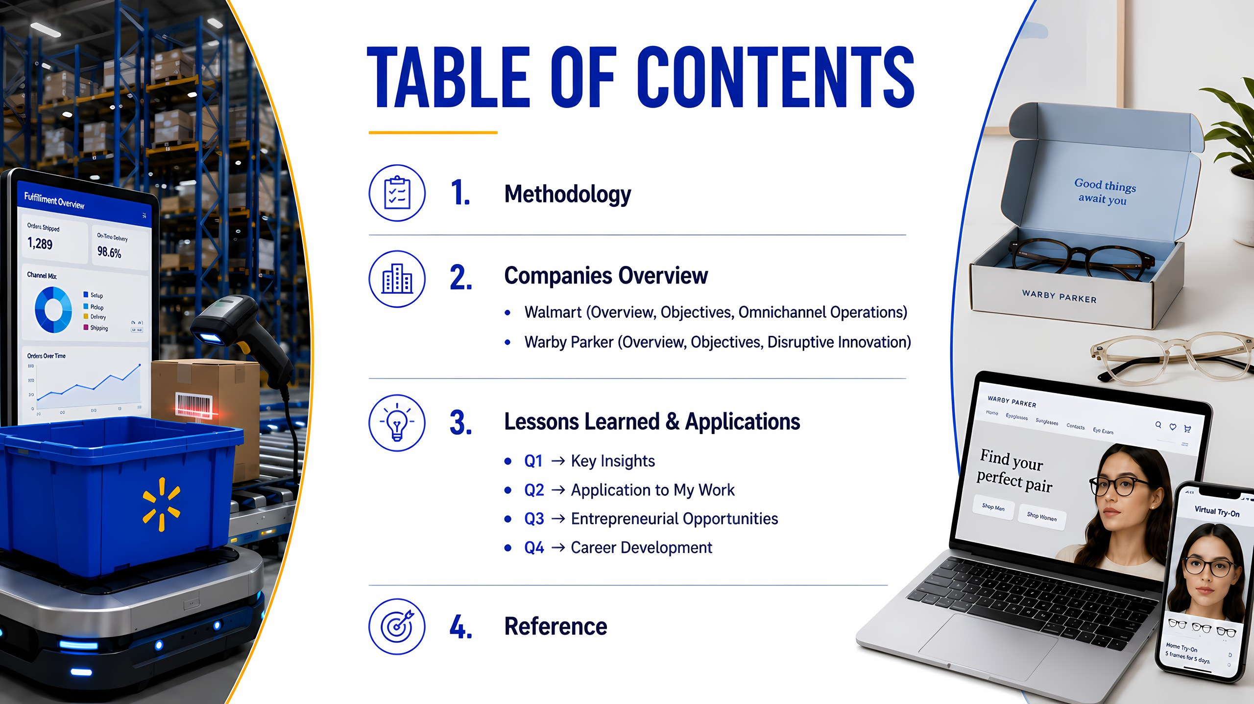
Notes:
Here's the agenda. I start with the methodology, then continue with Company overview and objectives before moving to the applications and lessons, finally reaching the conclusion.

Slide 3
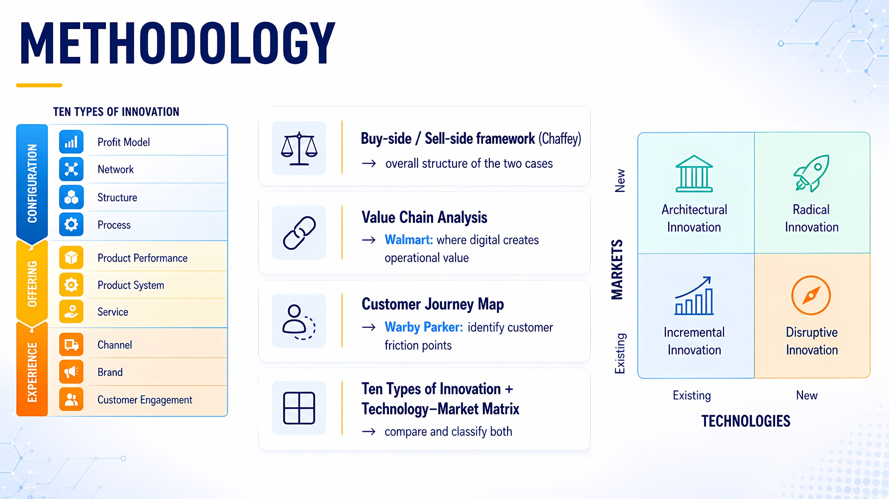
Notes:
For the methodology, I use the framework written by Chaffey, and different approaches for 2 cases. Walmart, I apply value chain analysis. For Warby Parker, I use customer journey map to identify friction points. In addition, I also use Ten Types of Innovation and Technology-Market Matrix.

Slide 4
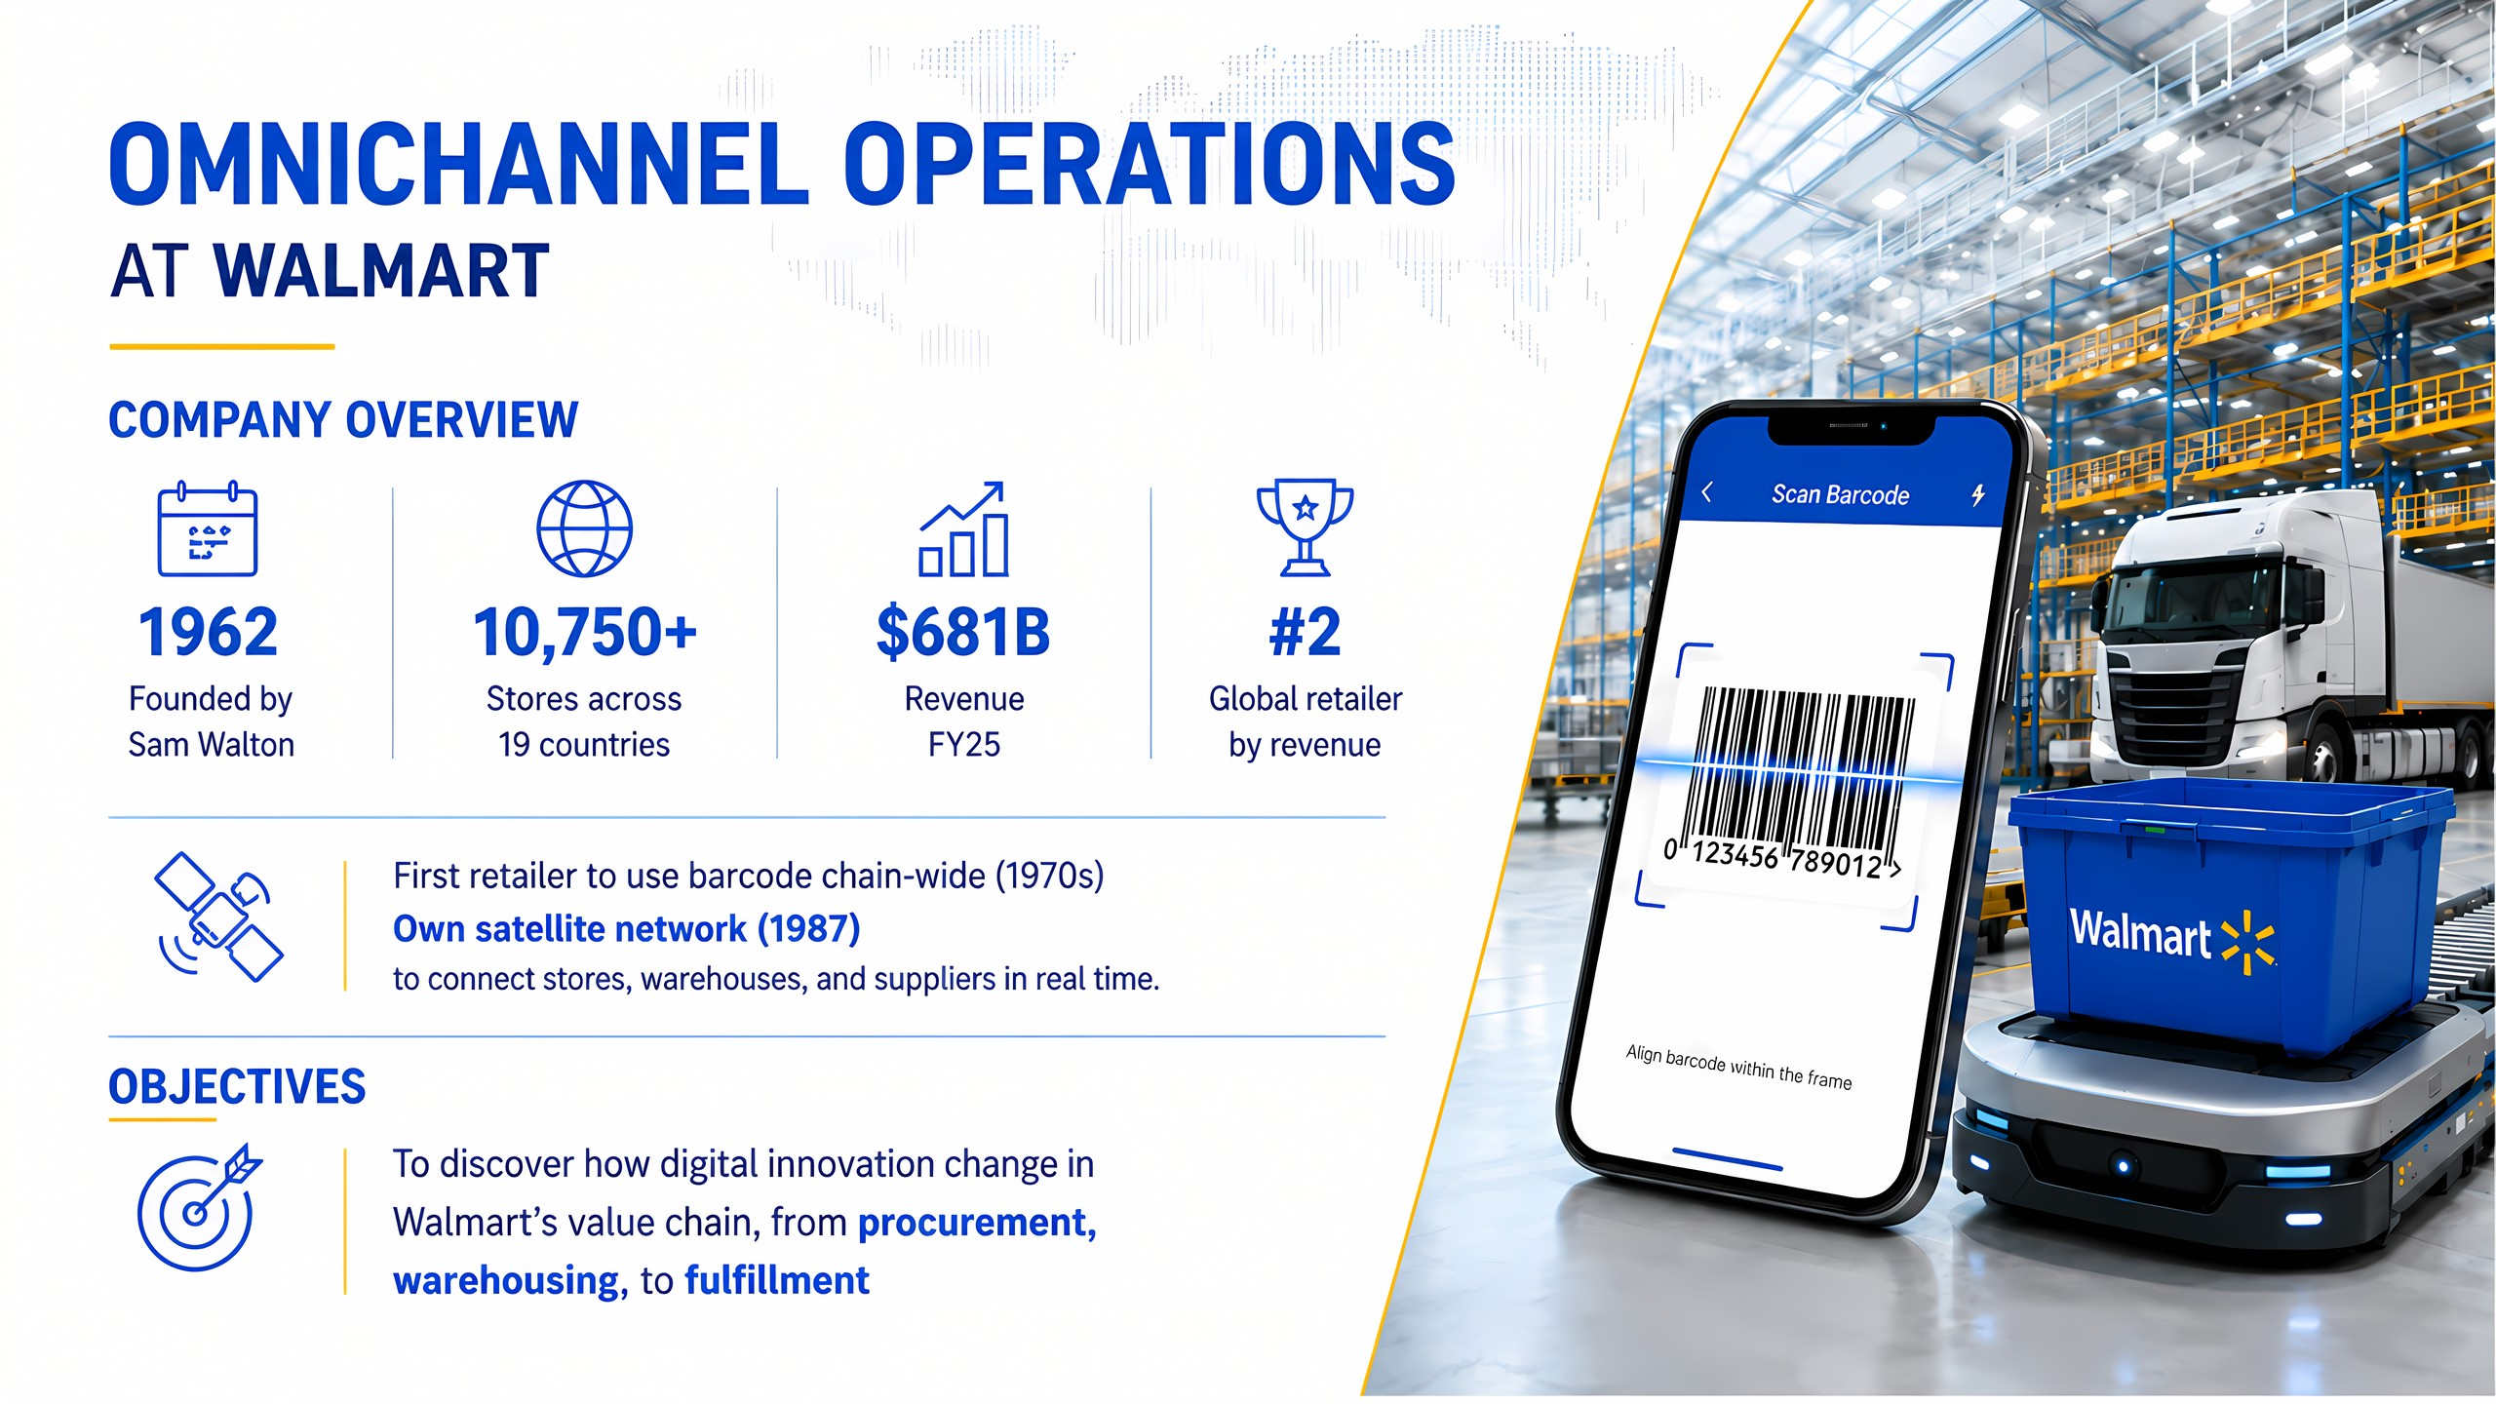
Notes:
We go through to Walmart first. There are more than 10.000 stores across 19 countries, which creates over 600 billion dollars, becoming the world's second-largest company by annual revenue, just behind Amazon. But in fact, Amazon only surpassed Walmart this year.
One of the reasons behind Walmart's success is the very early investment in the technology. They applied barcode and satellite networks to support their supply chain long ago.
The objective of the case is I would try to discover Walmart’s value chain to see how digital innovation transforms, from procurement and warehousing to fulfillment.

Slide 5
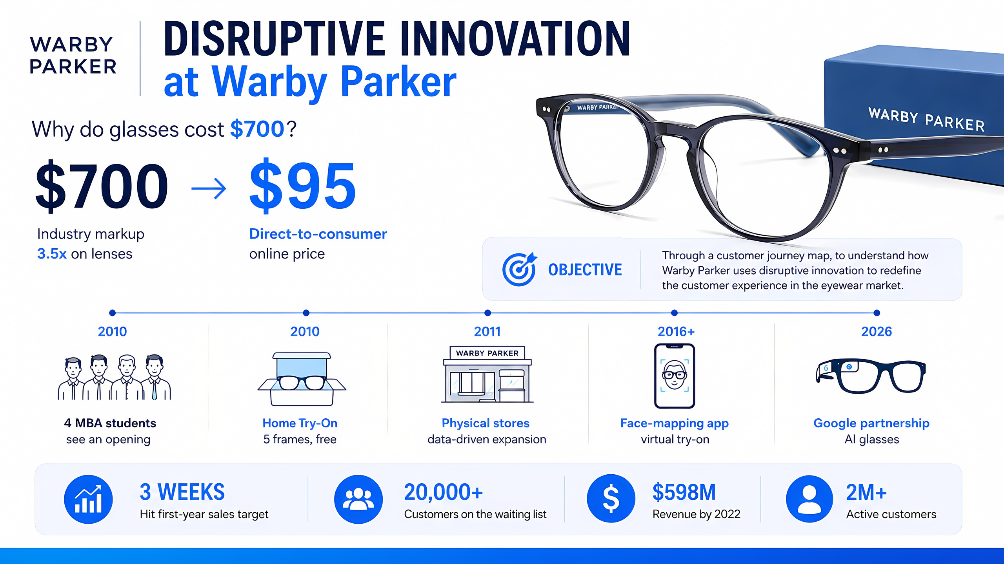
Notes:
Next is Warby Parker. When a pair of glasses cost 700 dollars, Why Warby Parker sells for only 95 dollars?
The answer is because of disruptive innovation. Instead of following the traditional retail model, they adopted online business model and low cost strategy, to remove many distribution layers, making eyewear much more affordable. My objective is to understand how Warby Parker re-design their customer journey despite being a new player in the market.

Slide 6
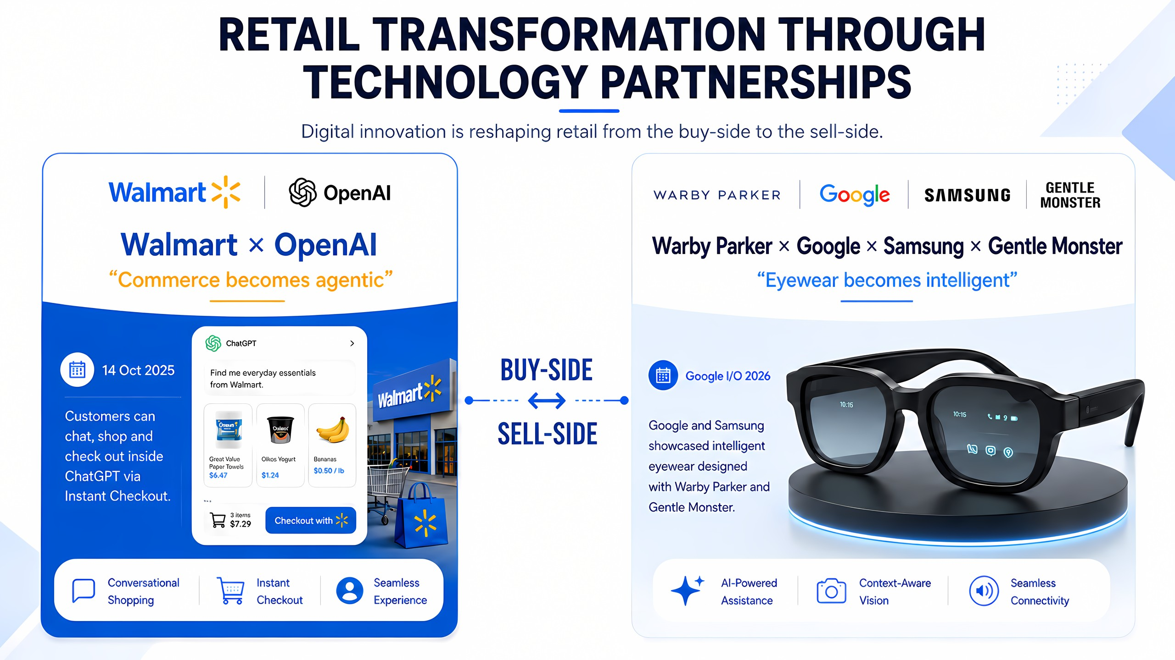
Notes:
One interesting similarity of the two companies is they build technology partnerships.
Walmart partnered with OpenAI, allowing customers to go shopping and instantly check out from ChatGPT. Warby Parker collab with Google, Samsung, and Gentle Monster to develop intelligent eyewear, which was introduced at Google I/O event last month.

Slide 7
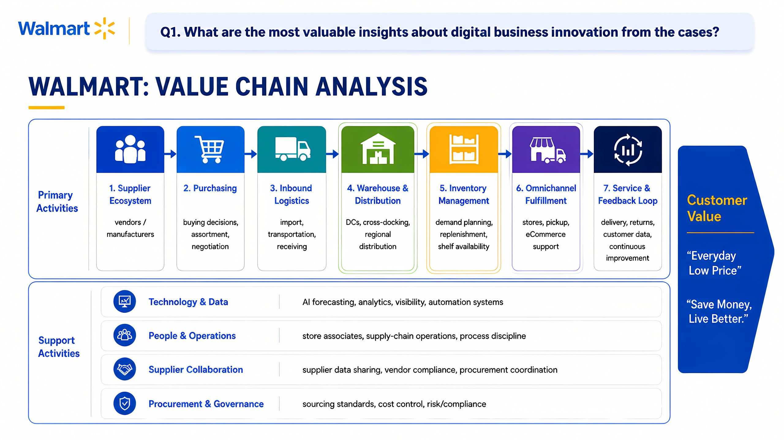
Notes:
Now I answer the first question: What is the most valuable insight from Walmart?
After doing value chain analysis, I can see that Walmart uses technology to connect every stage of the value chain. For instance, AI and data helps to manage the supplier ecosystem, forecast real-time demand, optimize inventory and fulfillment, so they can reduce operational costs, exactly right to the motto of “everyday low price” and “save money live better”.

Slide 8
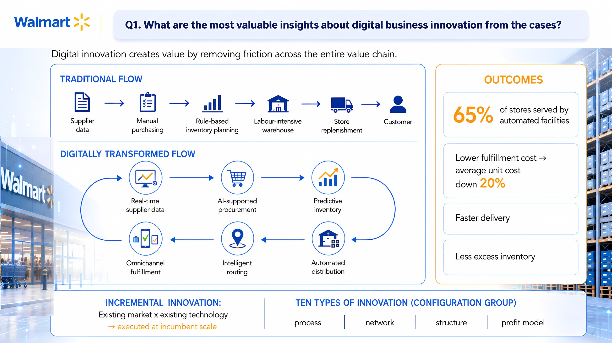
Notes:
After replacing the traditional flow with a digitally transformed flow, the efficiency can be seen in every stage: real-time supplier data, AI for procurement, predictive inventory, and omnichannel. The outcomes so impressive when 65% of stores are automated, lower cost, faster delivery, and excess inventory is controllable.
This is called incremental innovation, existing technology - to improve existing business, at incumbent scale to improve process, network, structure, and profit model (configuration group).

Slide 9
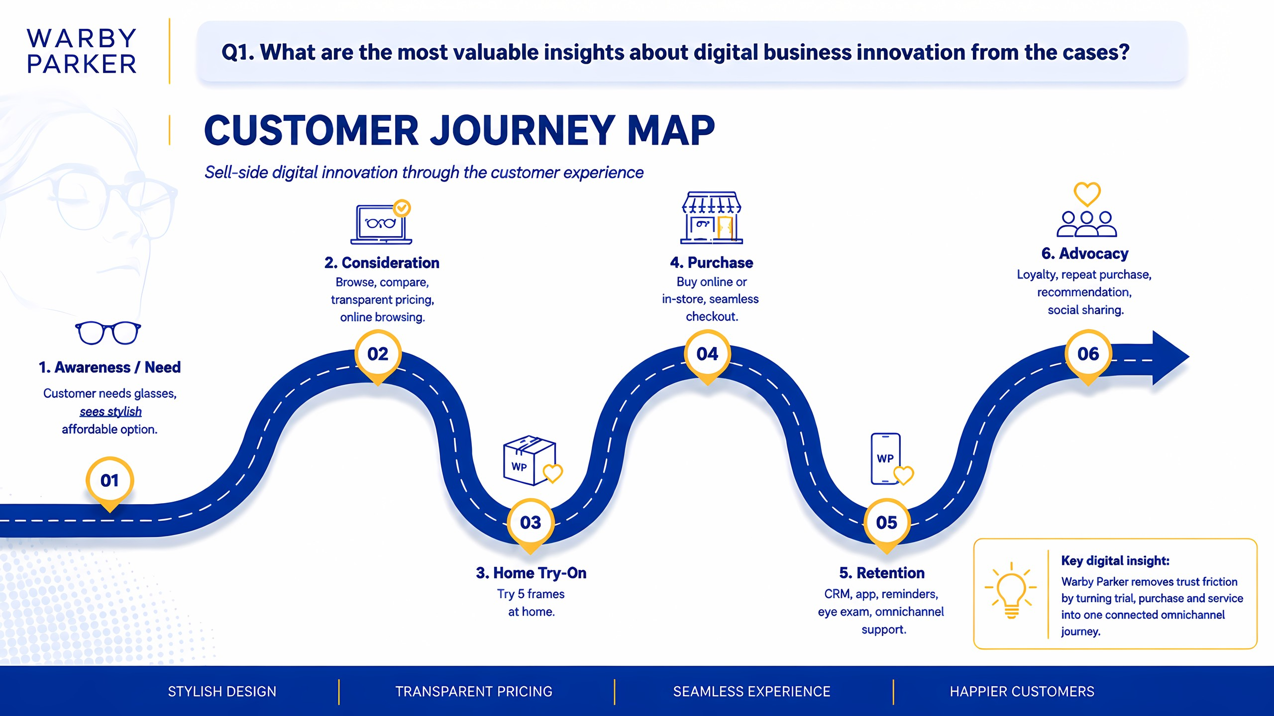
Notes:
Turning to Warby Parker, the customer journey map starts with recognizing demand, then understanding their searching behavior. Through the Home Try-On strategy, they send to customers five frames to try before buying. Last but not least, retention and advocacy are a critical part in building long-term relationships.

Slide 10
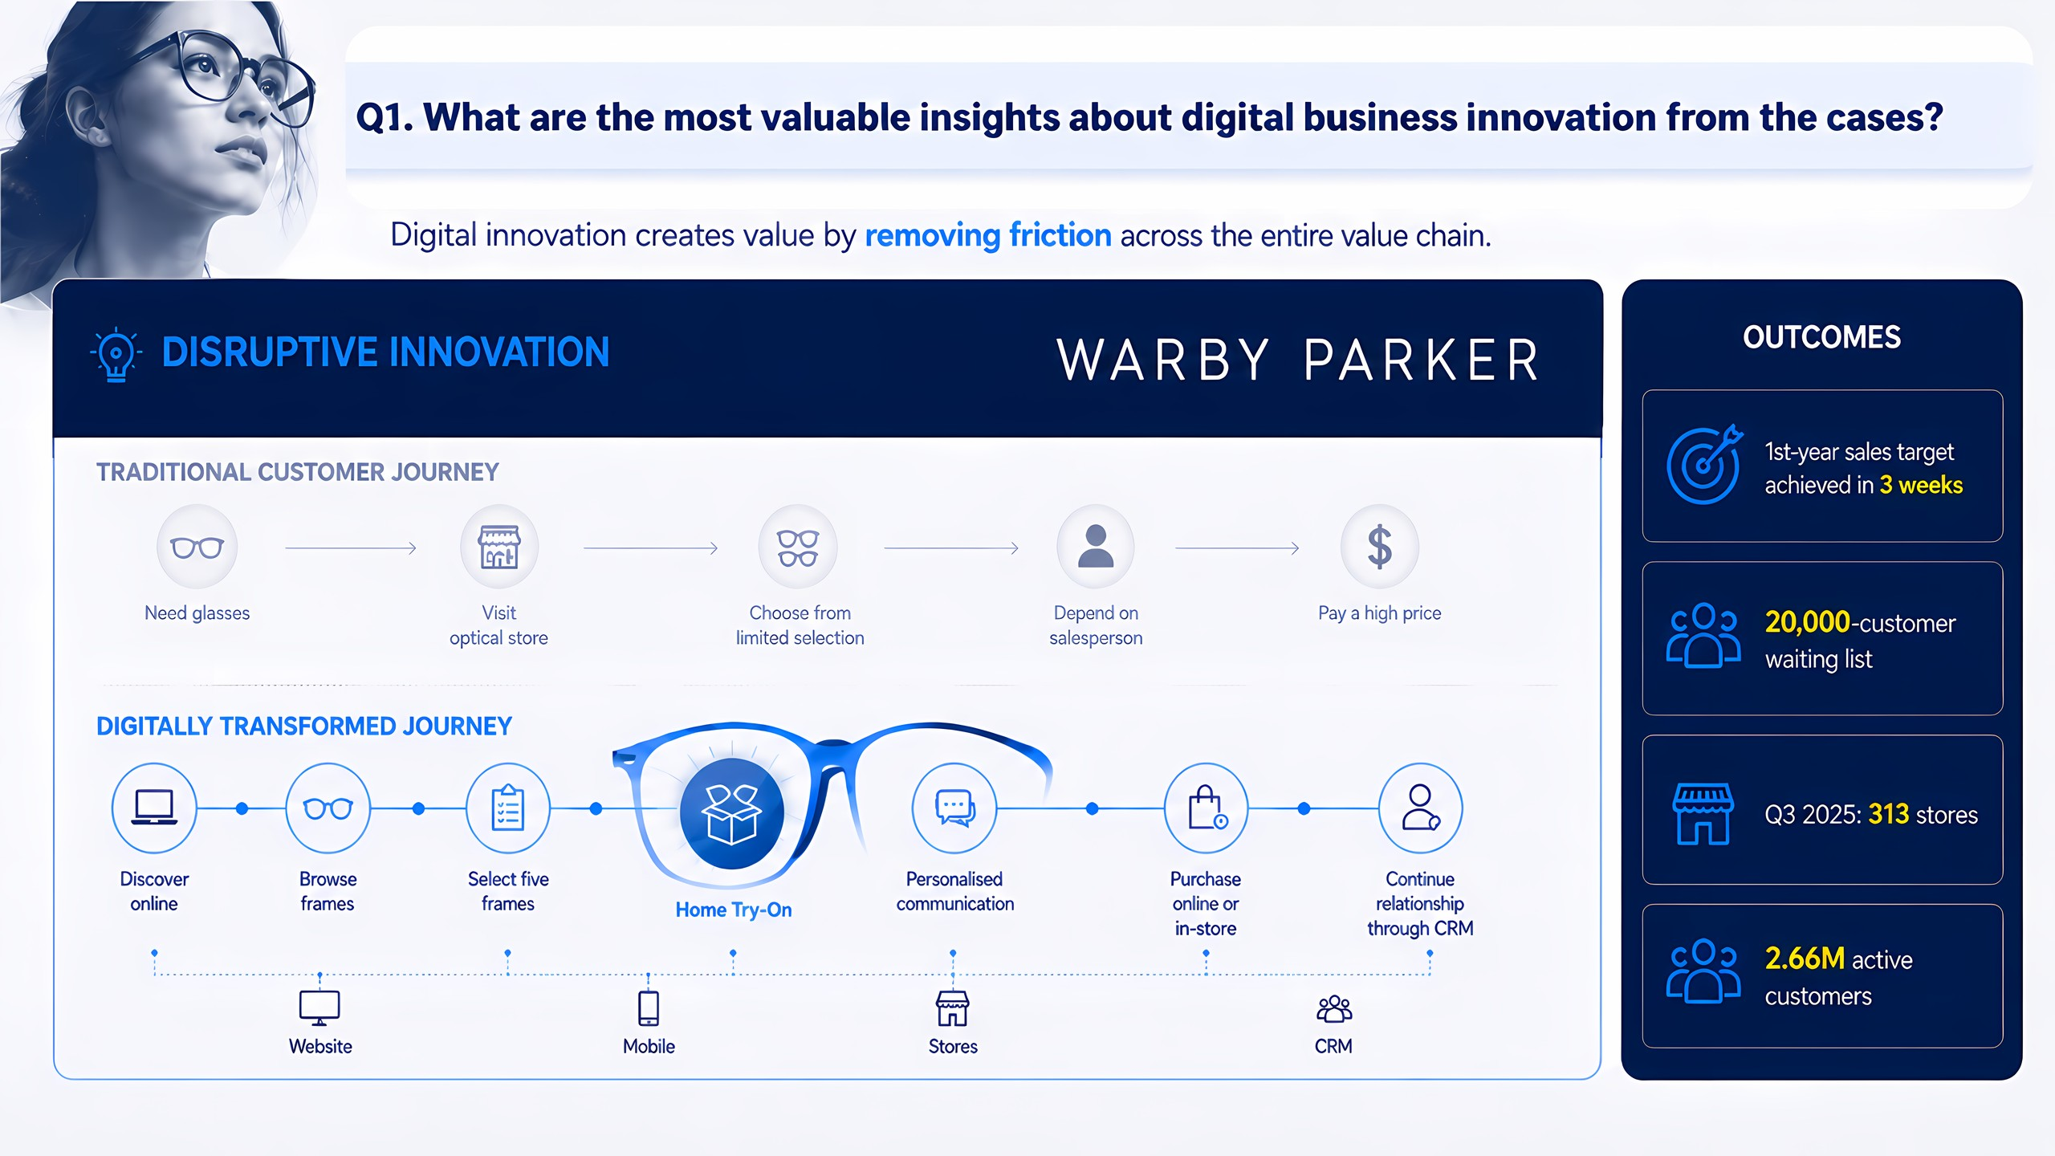
Notes:
Disruptive innovation is the highlight in the customer journey map I want to share. The company sells to customers at a cheaper price. They also launched Home Try-On programs in 2011 and Virtual Try-On app in 2019, becoming one of the pioneers in the eyewear industry. These innovations received many positive responses: achieved 1st-year sales targets in just three weeks, a long waiting list of customers, and they have more than 300 stores across the US and Canada.

Slide 11
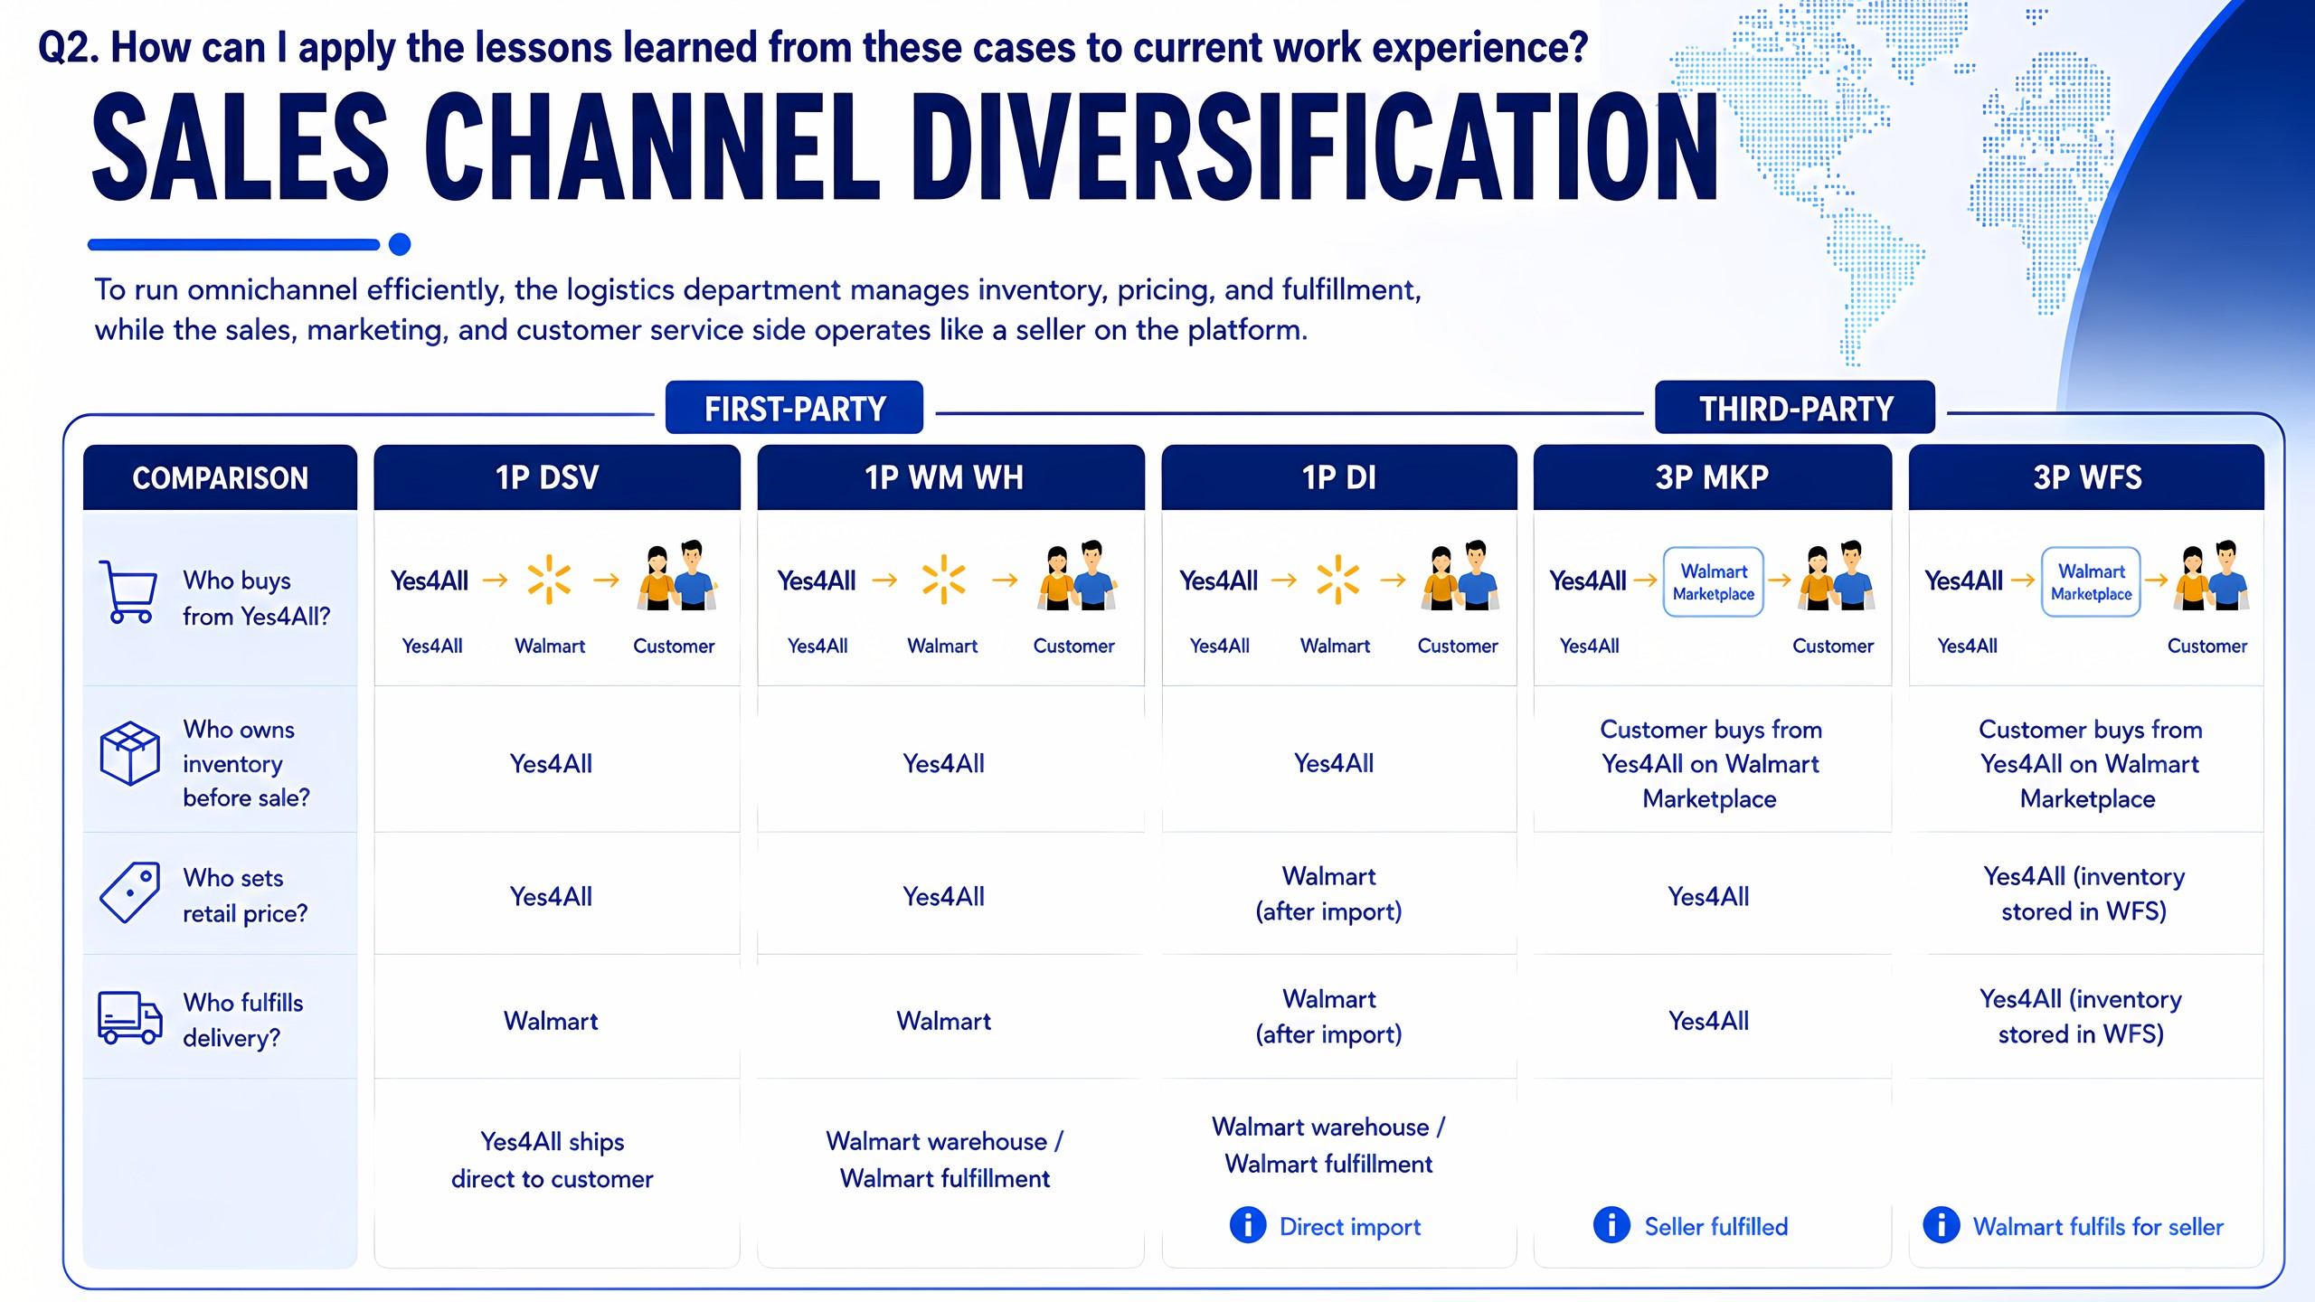
Notes:
Moving to my current work experience, I work for a company which operates as both a vendor and a seller on Amazon, Walmart, and eBay. On Walmart platform, we manage several sales channels, divided into first-party vendors and third-party sellers.
For the first-party, the channels include drop ship - Yes4All ships directly to customers; Walmart warehouse; and direct import (DI) - they handle importing and managing my company’s product.
For the third-party, the products can be listed on Walmart Marketplace, and Walmart Fulfillment Services - where they handle storage, packing, and shipping.
Overall, different channels require different decisions on pricing, inventory ownership, and how listing is displayed on the platform.

Slide 12
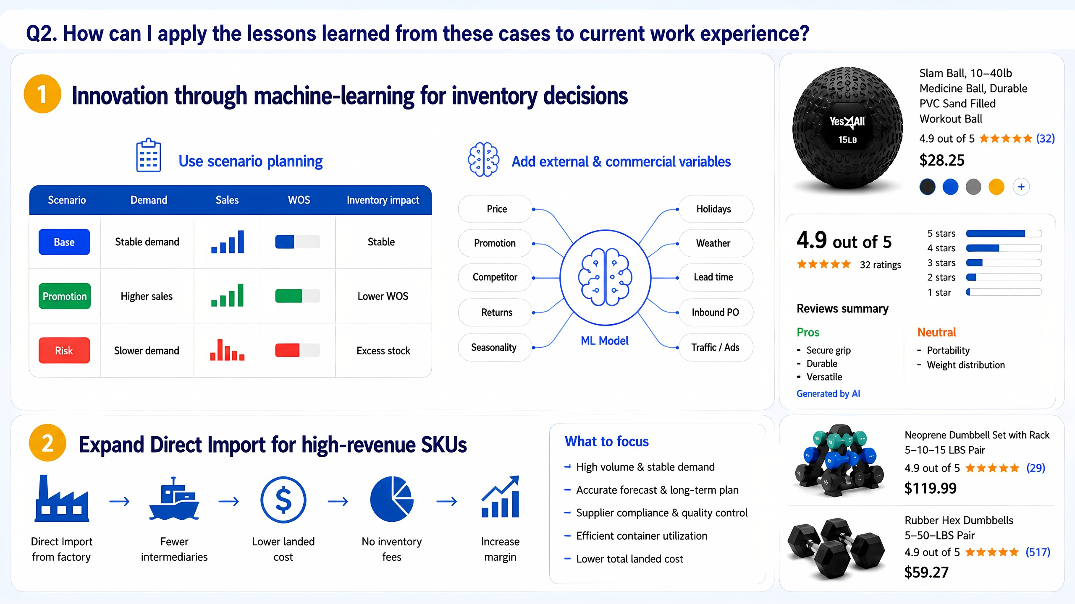
Notes:
After analyzing the two cases, here are applications for my work.
First, I propose to adopt machine learning to improve inventory forecasting, use scenario planning, and add more relevant variables to the model, which can increase forecast accuracy and prevent the SLOB (slow-moving and obsolete inventory).
Moreover, we try to expand the DI channel for high-revenue SKUs. This can reduce inventory holding costs so improving the profit margin.

Slide 13
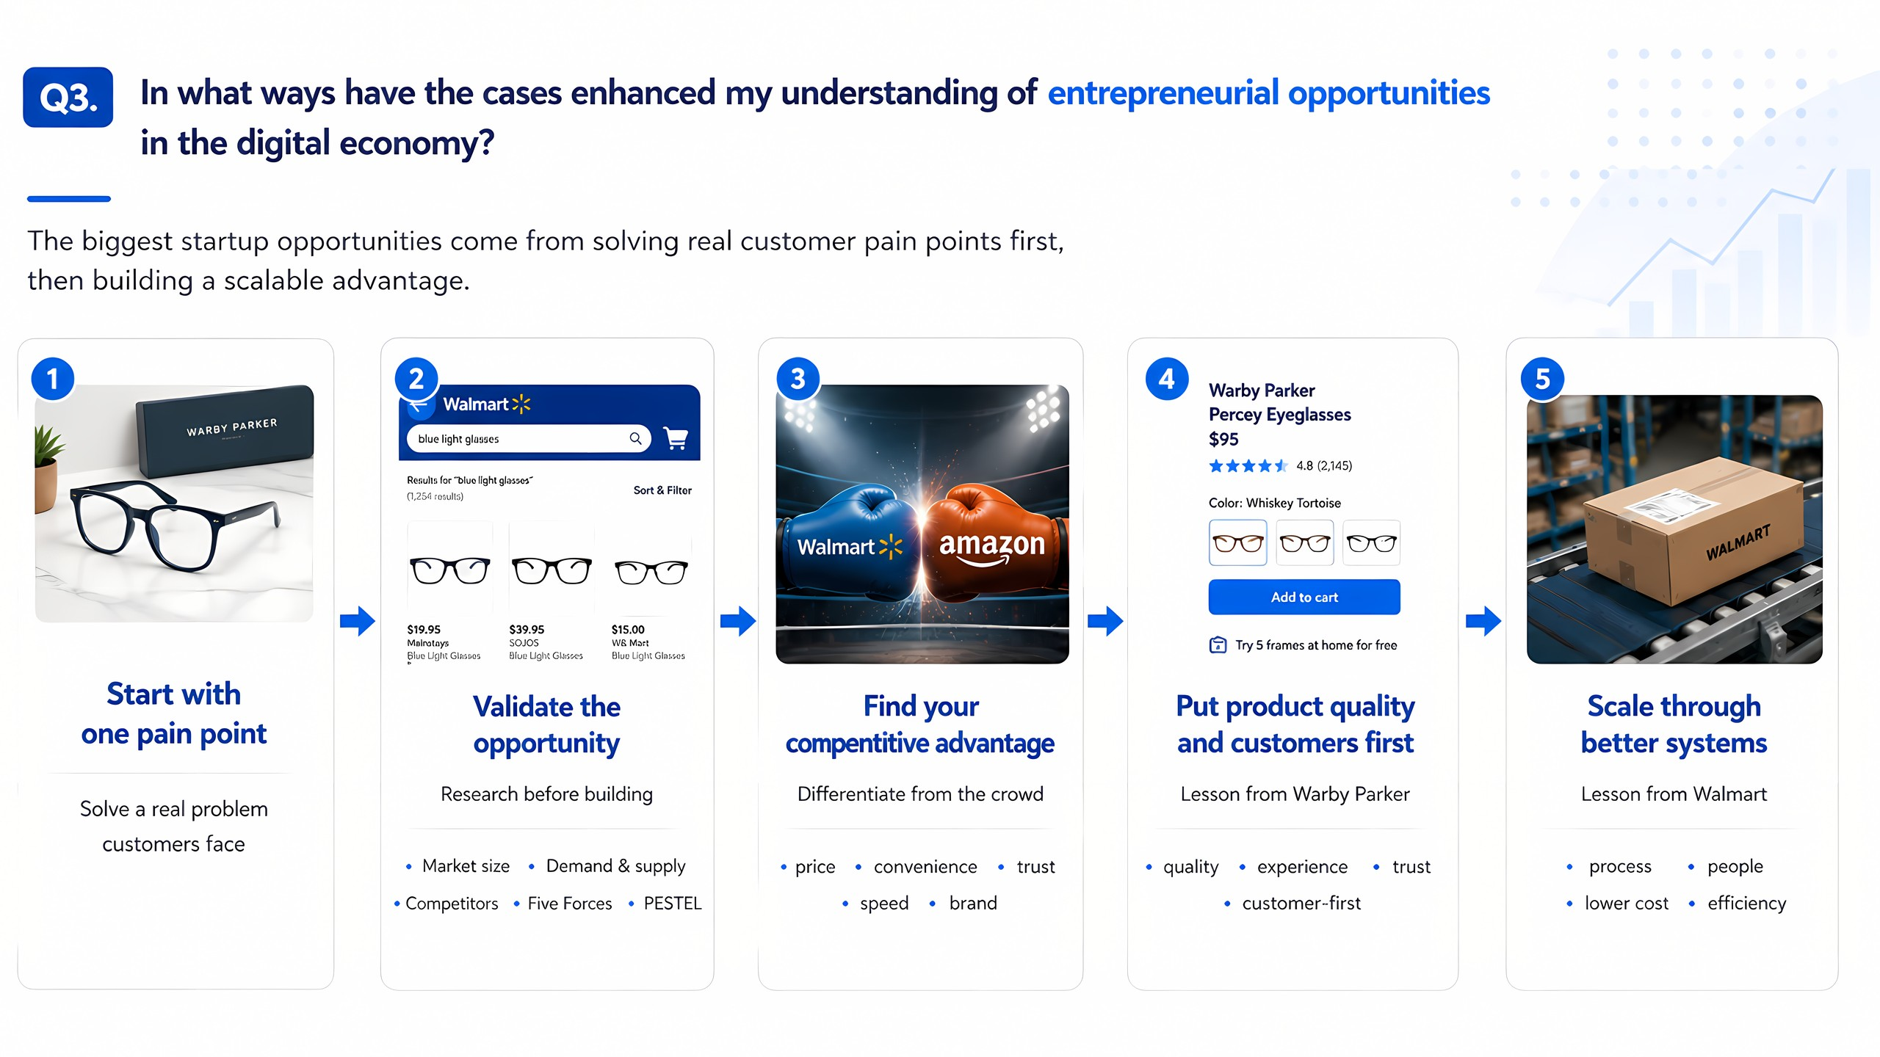
Notes:
I also learned that entrepreneurial opportunities should start with a real customer pain point. The next step is to validate that opportunity by researching demand, competitors, market size, then identify a competitive advantage. It is significant to gain differentiation if we operate a startup these days, and innovation is the key to scale the business in the long run.

Slide 14
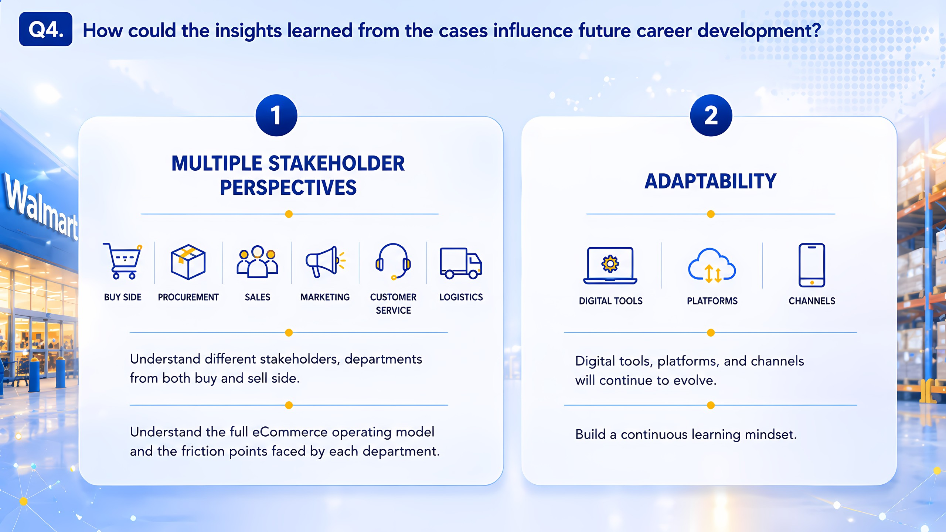
Notes:
Finally, the case influenced my future career in two ways.
First, I need to look at multiple perspectives when working with different stakeholders and departments - both buy-side or sell-side, in order that I can understand the full eCommerce operating model and the friction points faced by each department.
Second, adaptability is an essential skill. The digital world is always changing, so I need to build the habit of learning faster than the industry changes.

Slide 15
